Slide 1

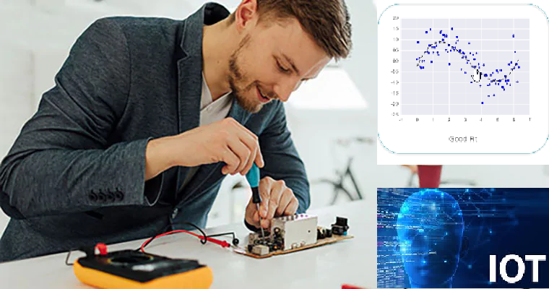



Wearable Devices and Computer Vision
Monday, July 20, 2020
Head Instructor: Jose Luis Ramirez Herran
TA’s: Souleymane Konate and Ricardo Villamil

Slide 2
Summary 1->7
Lecture 1. Students are getting the hardware while we Get started with the Sensor Tile development
Lecture 2. Introduce the basic signal processing concepts
Lecture 3. Introduce image processing – basic image operations
Lecture 4.
Tutorial 1 Troubleshooting
Introduction to Machine Learning and Human Activity Recognition
Numpy, Pandas, Matplotlib and Scikit learn.
Lecture 5. Regression
Lecture 6. Support Vector Machine Classification and PCA
Implementation of SVM in Python
Human Activity Classification Example: Optimizing of the Number and Placements of Wearable IMUs for Automatic Rehabilitation Recording
Lecture 7. Souleymane will us teach about:
Linear Systems in DSP
Impulse Function
Convolution
Low and High Pass Filter
Fourier and FFT
Ricardo is presenting some recent MIT MediaLab’s projects on Wearable Devices
Project Teams and Proposals
Lecture 8. Today’s Class:
SensorTile Tutorial Assignments
Teams and Projects
Today’s Class:
Teams and Projects
Project Report 1 - Presentations
SensorTile Tutorials
Data Collection And Tutorial 9

Slide 3
Today’s Class:
Teams and Projects
Project Report 1 - Presentations
SensorTile Tutorials
Data Collection And Tutorial 9

Slide 4
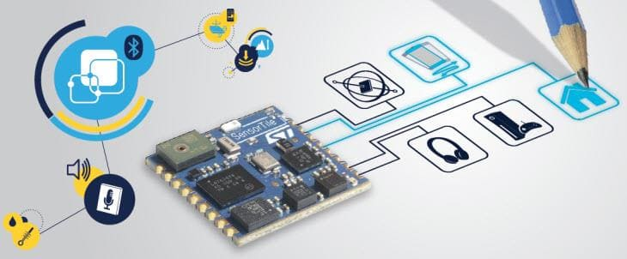
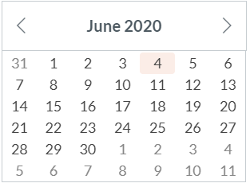
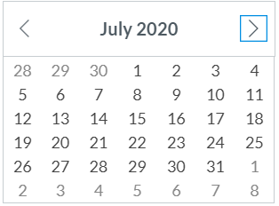
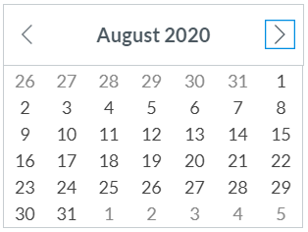
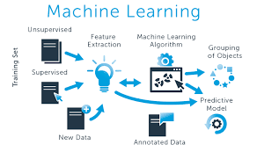
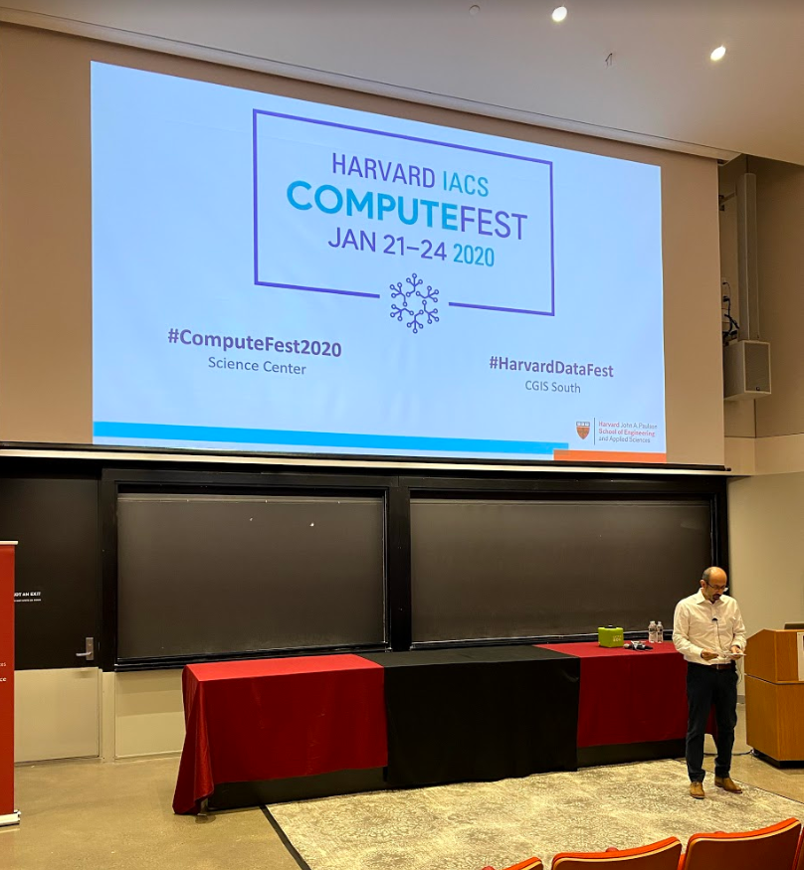
Calendar summer 2020
Mondays and Wednesdays 6:30 pm – 9:30 pm
Wearable Devices and Computer Vision
Lecture 6
Project
presentations
Su M Tu W Th F S
SW+HW Setup.+ Basic Tutorials

Slide 5

Today’s Lecture
Break
8:00 pm – 8:10 pm
Break
9:00 pm – 9:10 pm
Part 1
Part 2
Data Collection - Projects
Projects and teams - questions
Part 3
Checking in
Questions?
Project Report 1 - Presentations
8:10 pm – 9:00 pm
6:30 pm – 8:00 pm
9:10 pm – 9:30 pm

Slide 6
Break
8:10 pm – 8:20 pm
6:30 pm – 8:10 pm
Part 1
Project Report 1 - Presentations

Slide 7
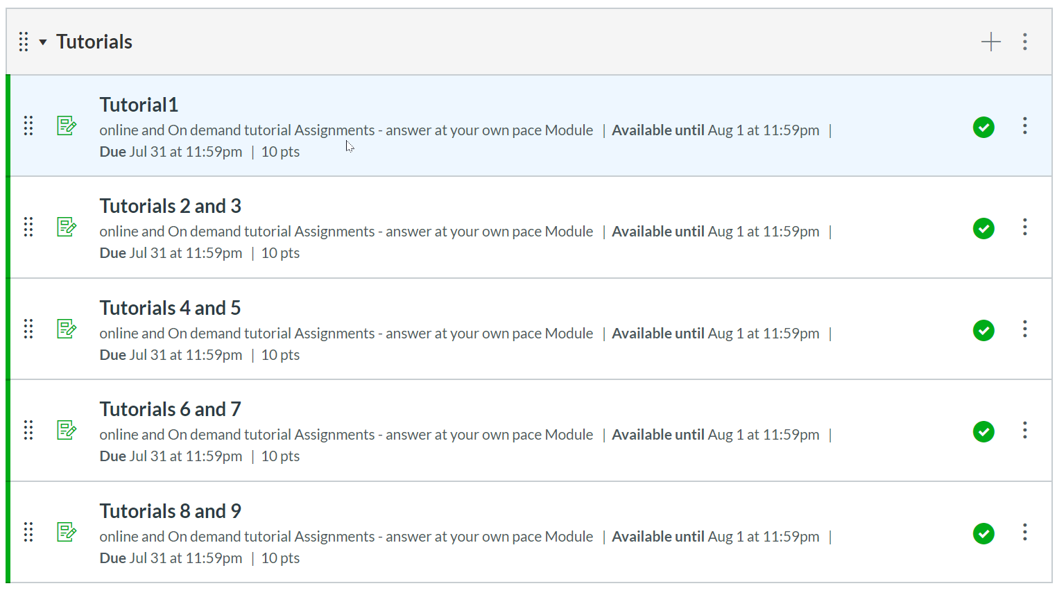
Tutorials

Slide 8
Today’s Lecture
Break
8:00 pm – 8:10 pm
Break
8:40 pm – 8:50 pm
Part 1
Part 2
Data Collection - Projects
Part 3
Questions?
Projects and Teams
Summary
Regression Algorithms by Souleymane Konate
Projects and teams - questions
6:30 pm – 8:00 pm
8:10 pm – 9:00 pm
9:00 pm – 9:30 pm

Slide 9
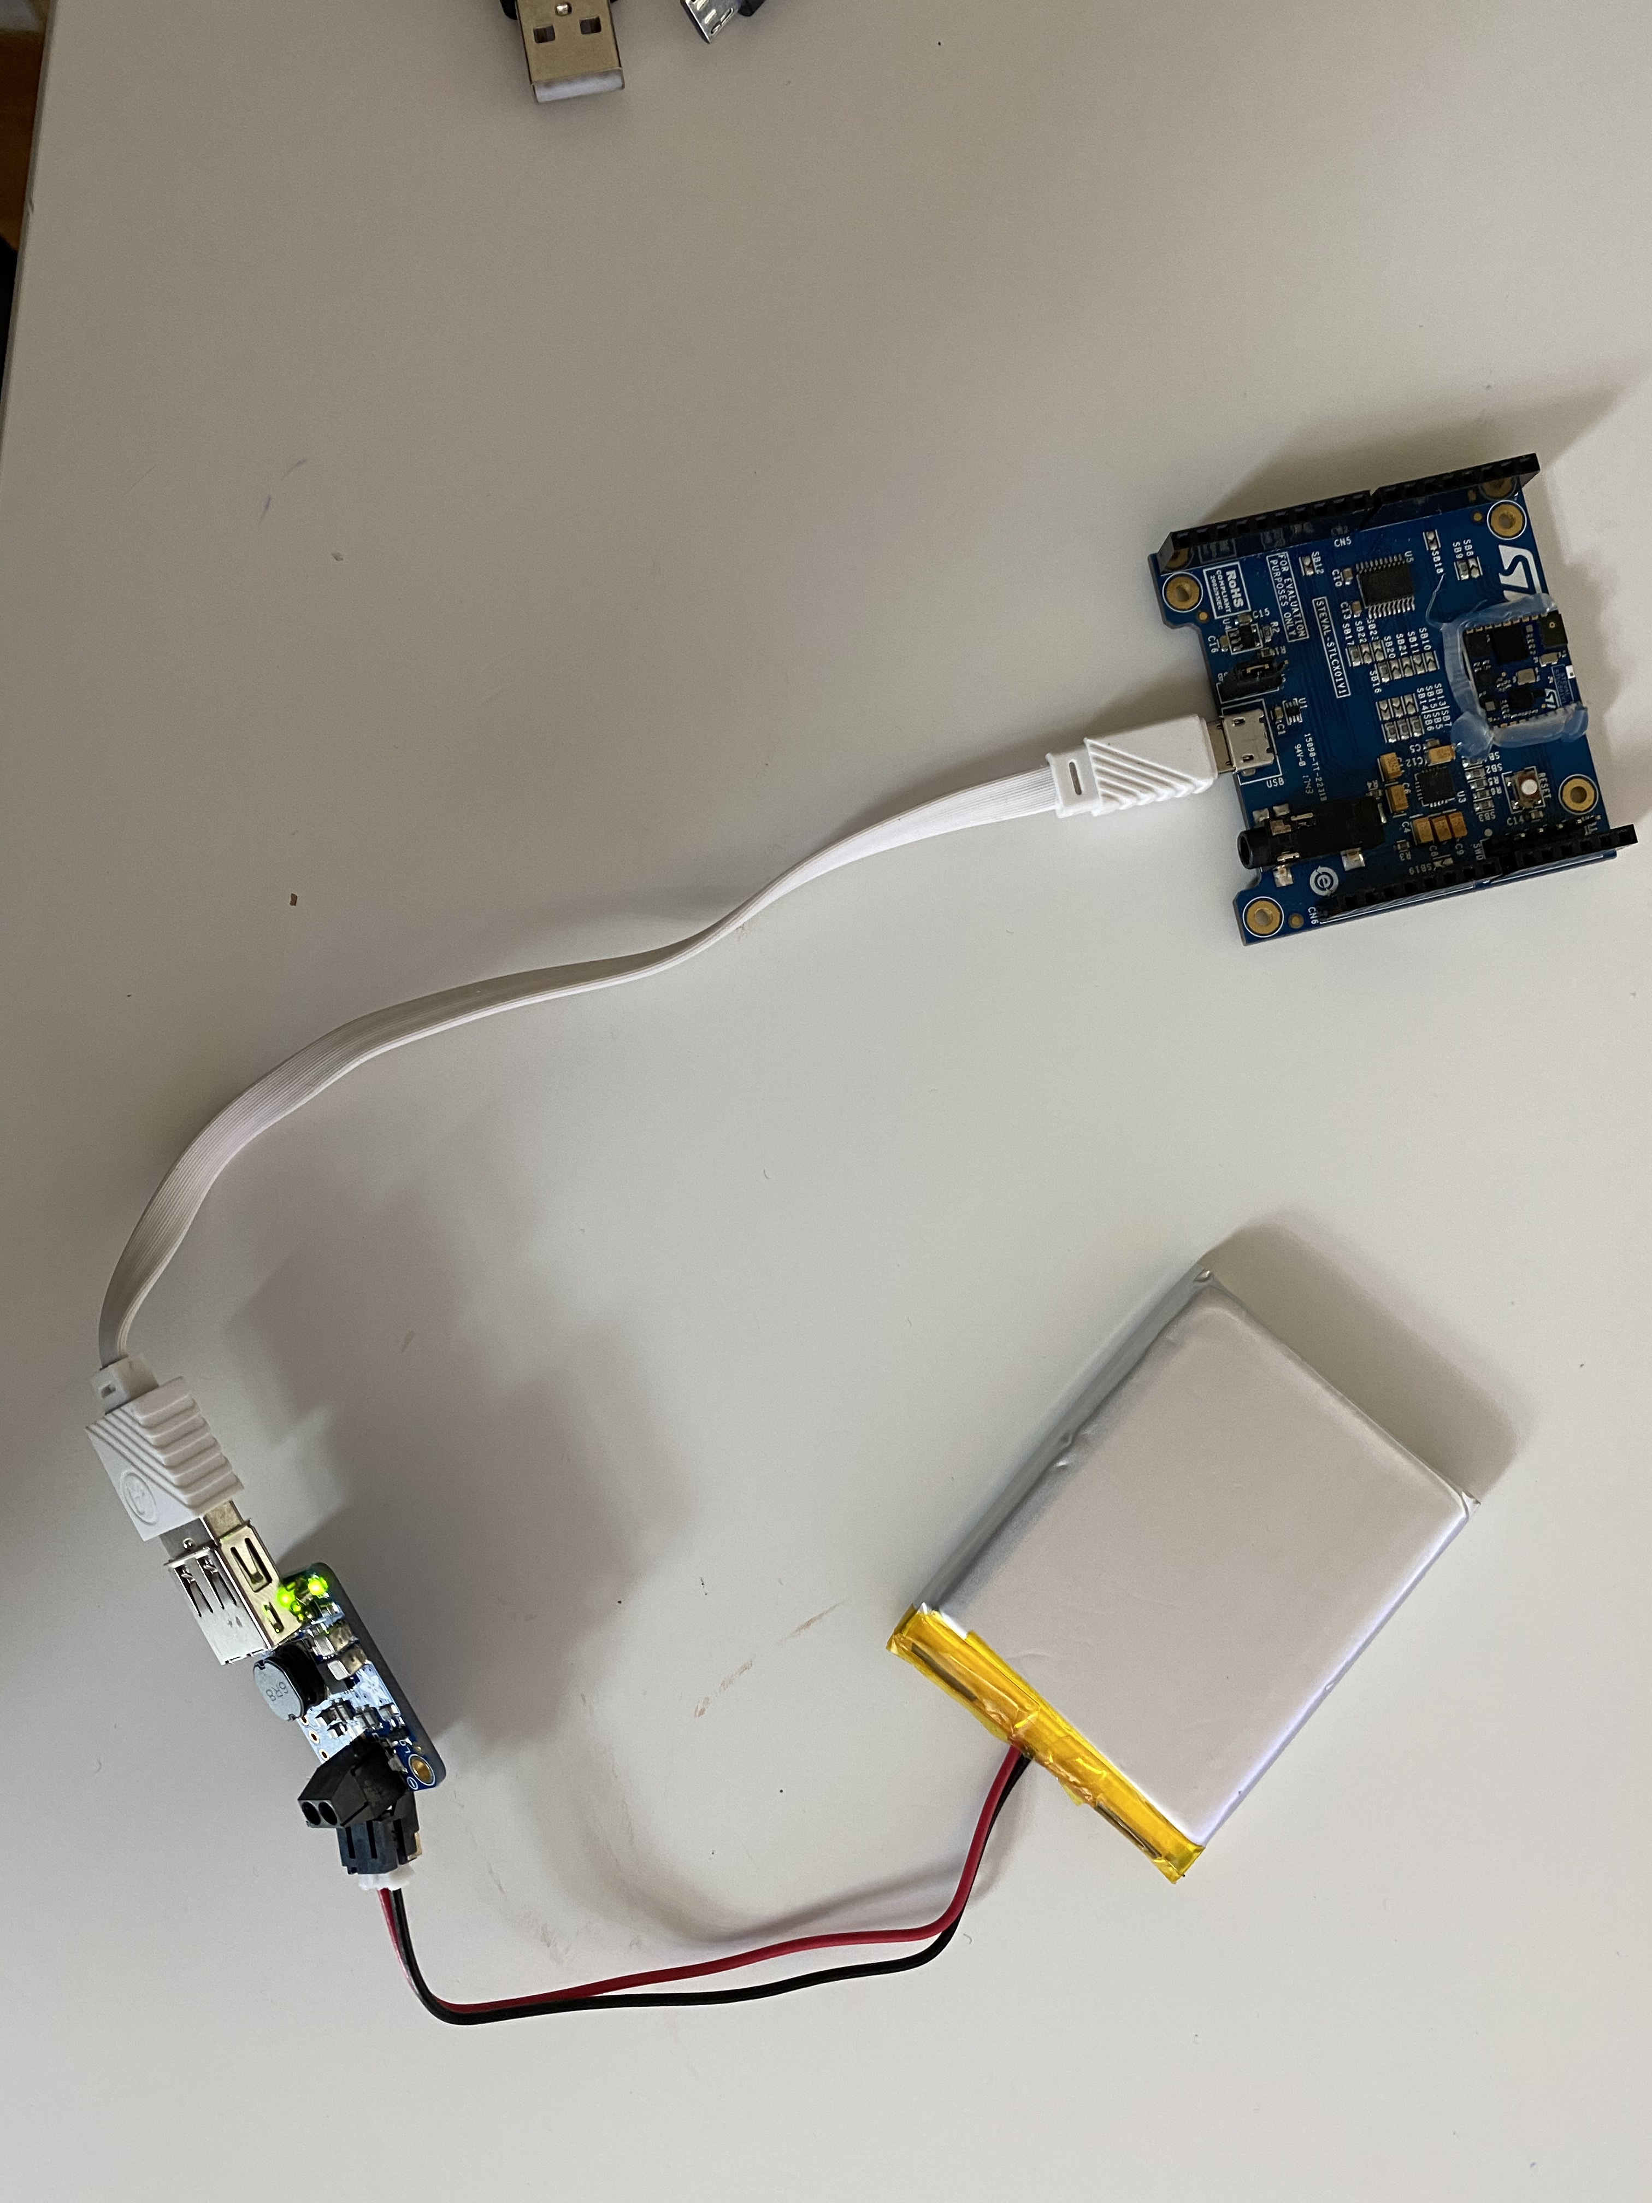
Data collection with the cradle
SensorTile expansion Cradle board equipped with audio DAC, USB port, STM32 Nucleo, Arduino UNO R3 and SWD connector
Tutorial 8 up to page 10.
Config you firmware to send data via BLE (Bluetooth Low Energy)
Compile FP-SNS-ALLMEMS1
Successfully Flash the Sensor with the files above
Disconnect Sensor from any cable
Power the Sensor with a 5V, 1A powers source via microUSB
Connect to the sensor via BLE
Get the data
BinaryFile :
C:\Users\jose\workspace\STM32CubeFunctionPack_ALLMEMS1_V3.1.0\Projects\Multi\Applications\ALLMEMS1\SW4STM32\STM32L476RG-SensorTile\STM32L4xx-SensorTile\Debug\ALLMEMS1_ST.bin
Bootloader:
C:\Users\jose\workspace\STM32CubeFunctionPack_ALLMEMS1_V3.1.0\Utilities\BootLoader\STM32L476RG

Slide 10
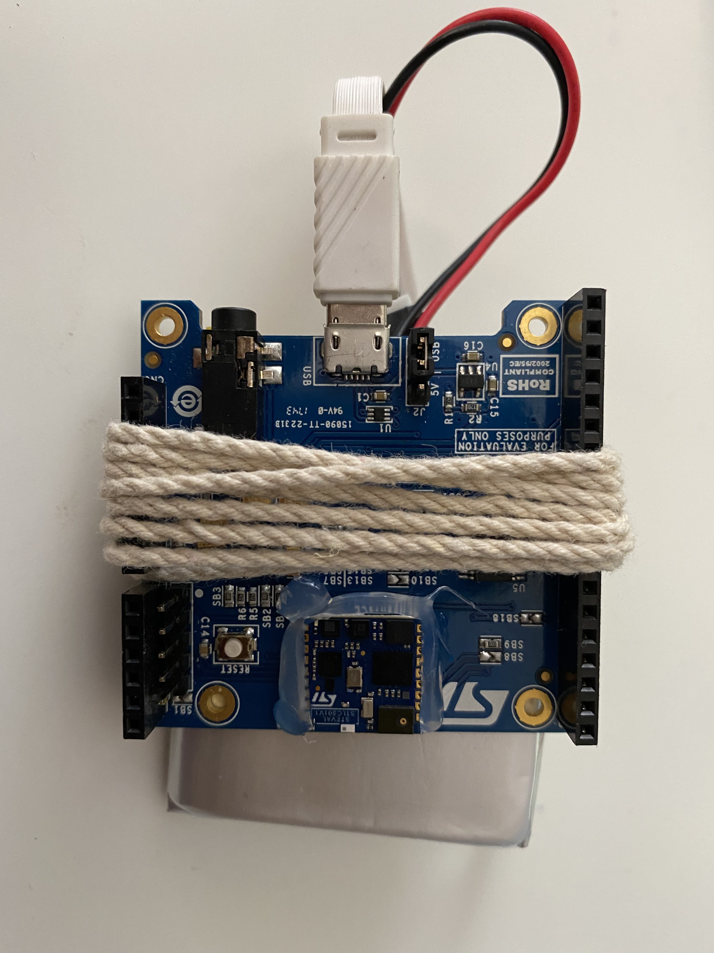
Option 1 using the power boost 3.7 to 5V rechargeable + usb to micro-usb cable

Slide 11
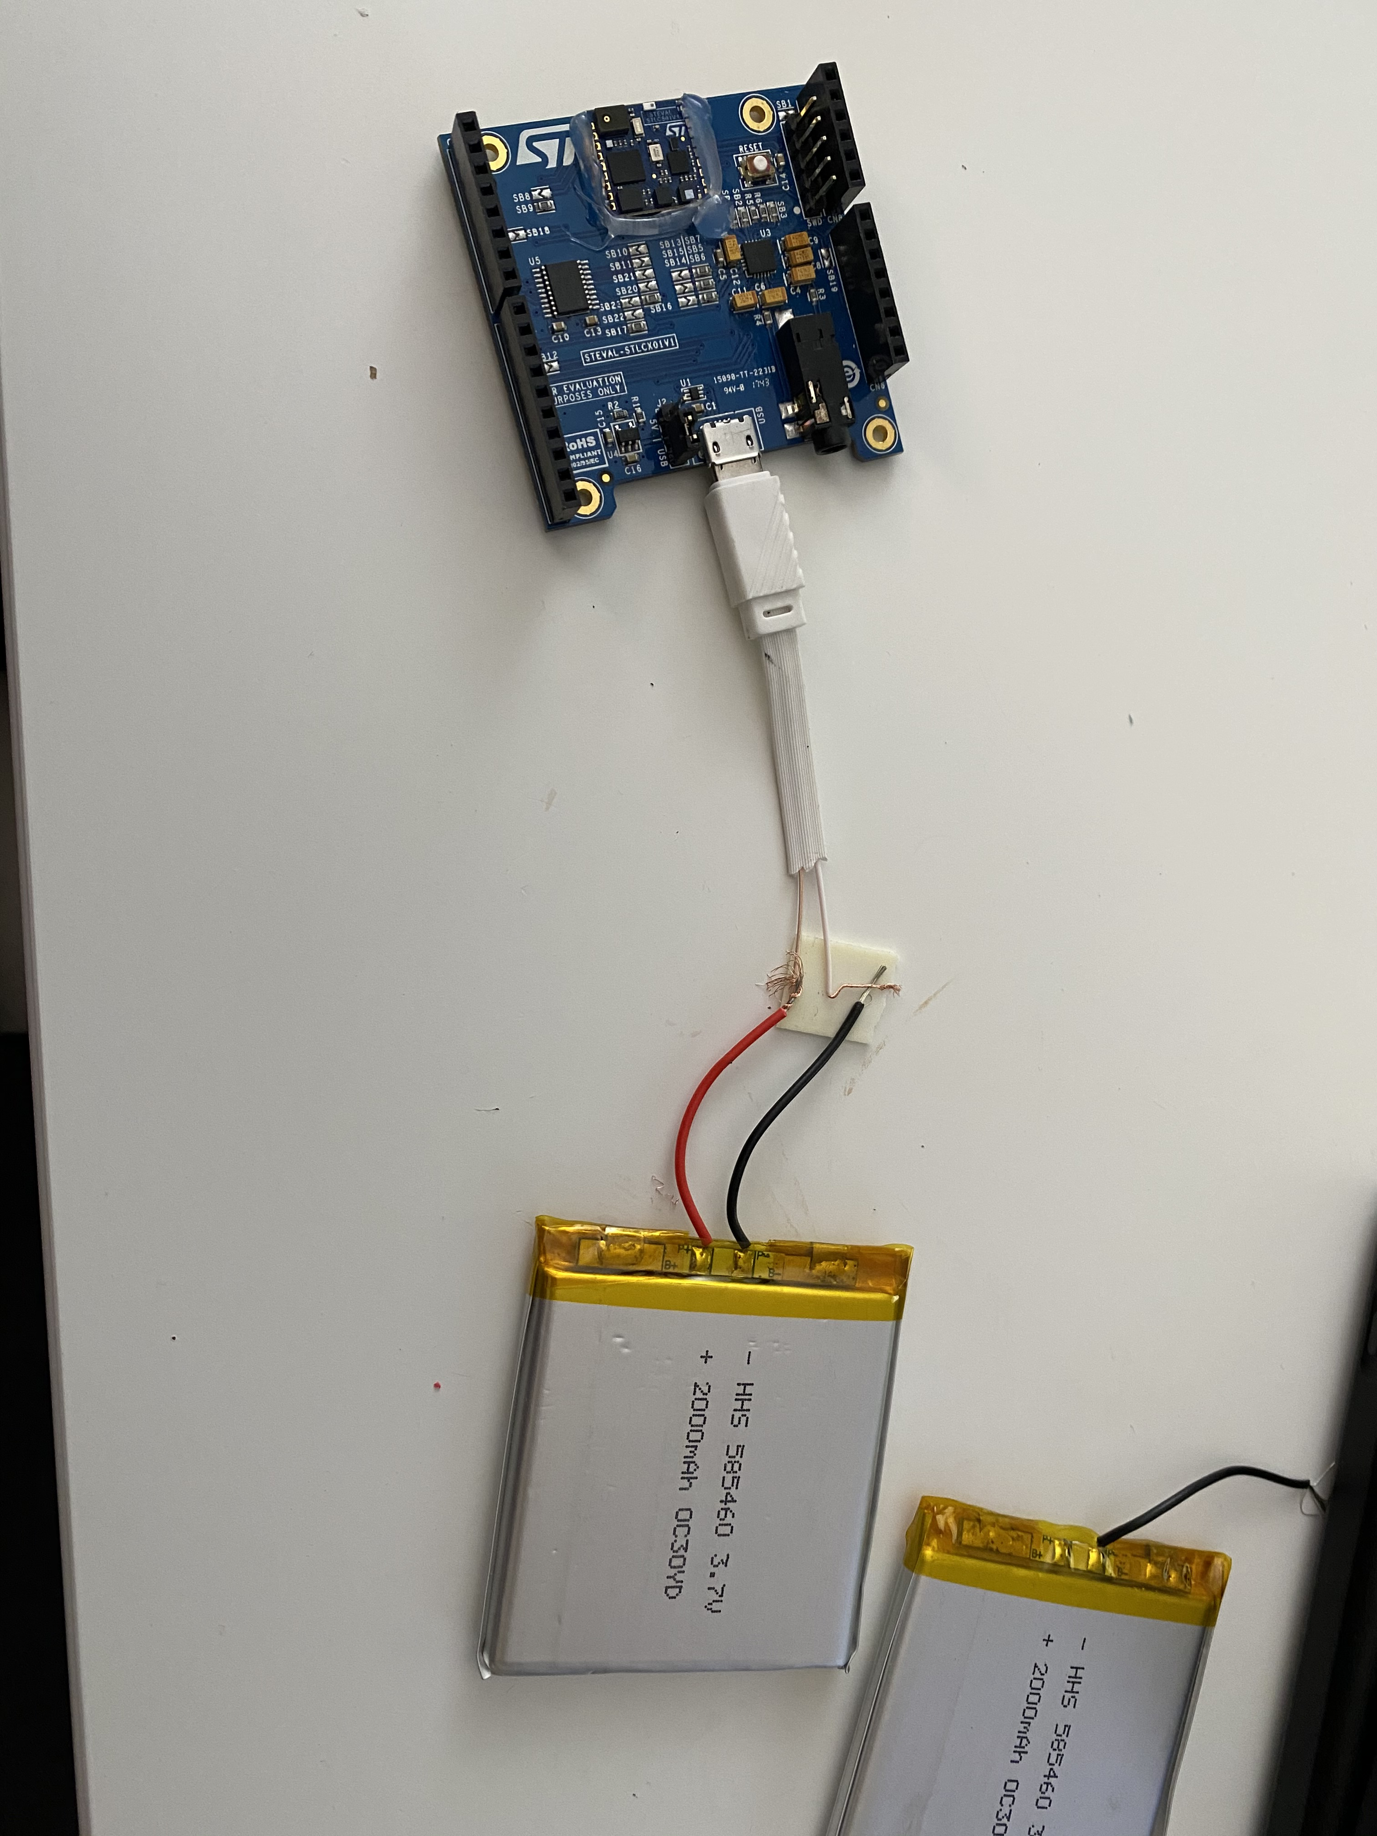
3.7V 2000mAh + USB A to micro-USB option

Slide 12
Bill of materials
No. Description url price otherProviders
Item 1 PowerBoost 500 Charger - Rechargeable 5V Lipo USB Boost @ 500mA https://www.adafruit.com/product/1944 $14.95 https://www.digikey.com/product-detail/en/1944/1528-1486-ND/5761270 https://www.amazon.com/dp/B00XW2MEW0?tag=amz-mkt-chr-us-20&ascsubtag=1ba00-01000-org00-win10-other-nomod-us000-pcomp-feature-scomp-wm-5&ref=aa_scomp_sosp1
Options for batteries (vist Adafruit.com):
Lithium Ion Polymer Battery - 3.7v 150mAh
Item 2 Lithium Ion Polymer Battery - 3.7v 2500mAh https://www.adafruit.com/product/328 https://www.digikey.com/products/en?mpart=328&v=1528
https://www.adafruit.com/product/2011
Lithium Ion Polymer Battery Ideal For Feathers - 3.7V 400mAh

Slide 13
Today’s Lecture
Break
7:40 pm – 7:50 pm
Break
8:40 pm – 8:50 pm
Part 1
Part 2
Python for:
Linear and Logistic Regression using Python
Questions
Part 3
Projects and Teams
Questions?
Summary
Regression Algorithms by Souleymane Konate
6:30 pm – 7:50 pm
7:50 pm – 8:40 pm
8:50 pm – 9:30 pm

Slide 14
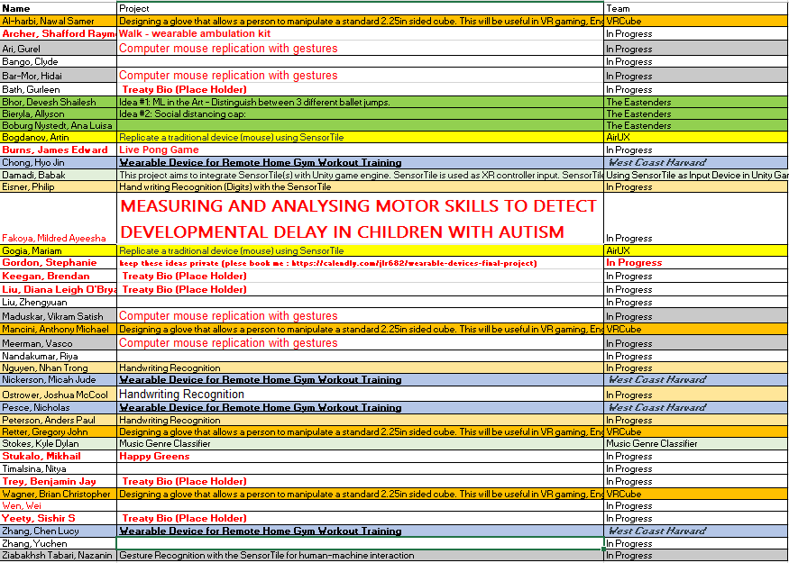
Teams and projects

Slide 15
Troubleshooting tutorials in canvas
We have very effective office hours so far and we can show some videos were we solved specific problems related with the tutorials. Please take a look in Canvas and we hope this videos help you to get started with the sensorTile curriculum. They will be published into the canvas modules.
Piazza

Slide 16
Office hours
emails TA's:
sok462@g.harvard.edu
ricardo_villamil@fas.harvard.edu
Calendly me:
https://calendly.com/jlr682/wearable-devices-final-project

Slide 17
Questions?

